Slide 1
Advances in Digital Identity
Steve Plank
Identity Architect

Slide 2

Identity
no consistency
Naming
DNS
Connectivity
IP

Slide 3
taught users
type
usernames &
passwords
web page

Slide 4
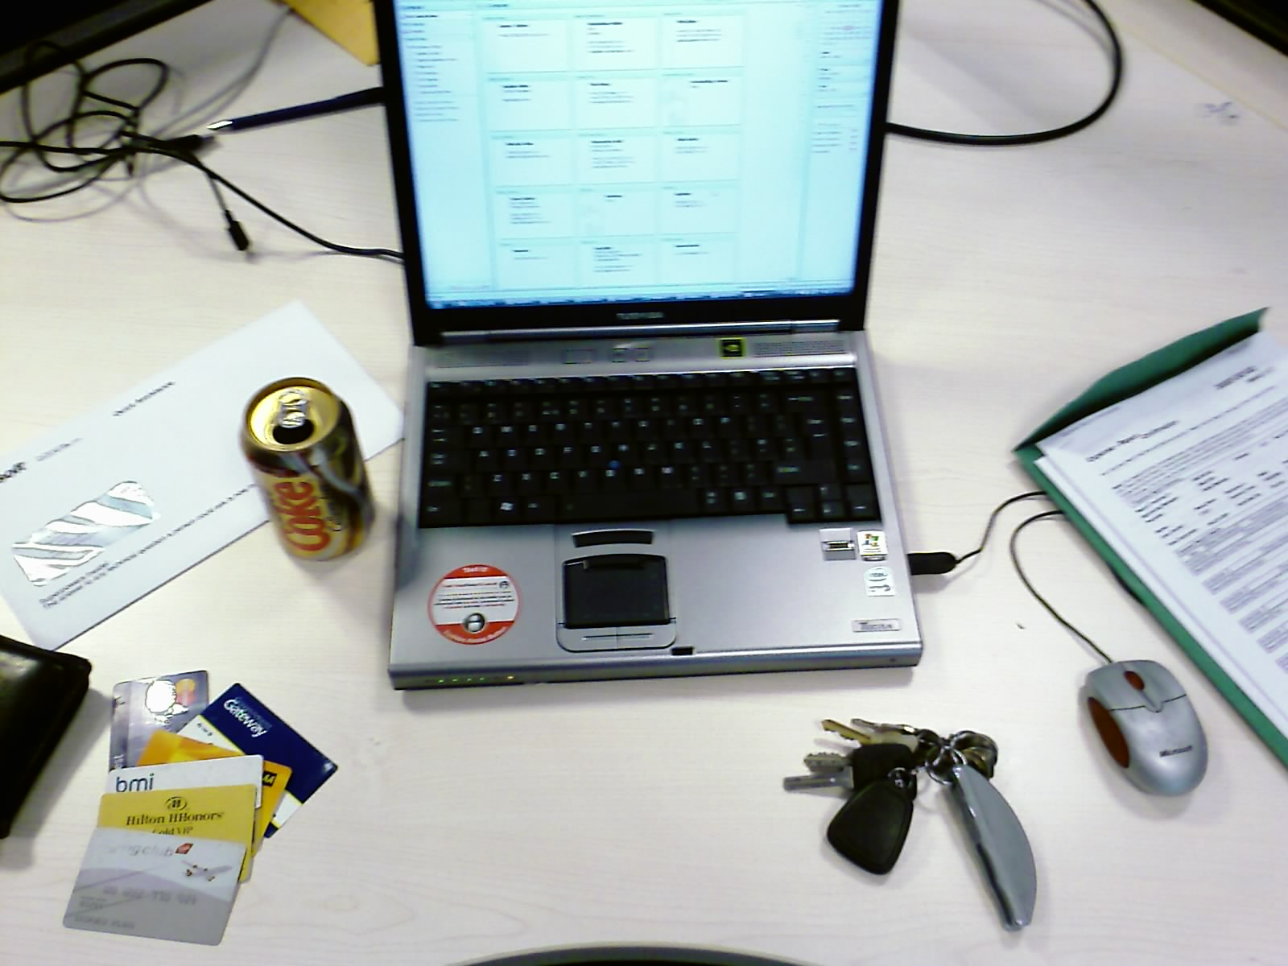
what is identity?

Slide 5
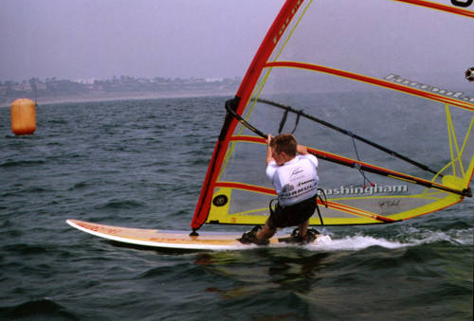

attributes:
givenName
sn
preferredName planky
dateOfBirth 170685!
over18 true
over21 true
over65 false
image
steve
plank

Slide 6
self asserted
what claims i make
about myself
verifiable
what claims another party
makes about me

Slide 7
elvis presley
only 1 of them is real
probably

Slide 8
trust
claims
make these

Slide 9
SECURITY TOKEN
steve
plank
over 18
over 21
under 65
image

Slide 10

security token service
give it something
SECURITY TOKEN
Steve
Plank
Over 18
Over 21
Under 65
image
DIFFERENT
SECURITY
TOKEN
Username
Password
Biometric
Signature
Certificate
“Secret”

Slide 11
identity metasystem

Slide 12



participants
subject
identity provider
relying party (website)

Slide 13
identity
provider
identity
provider
relying party
relying party
SAML
SAML
x509
x509
security
token
service
WS-*
security
token
service
WS-*
WS-*
identity selector
subject

Slide 14
identity selector

Slide 15
human integration
consistent experience across contexts

Slide 16
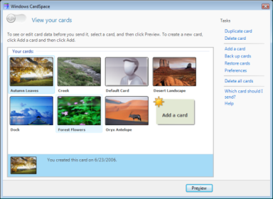

Slide 17

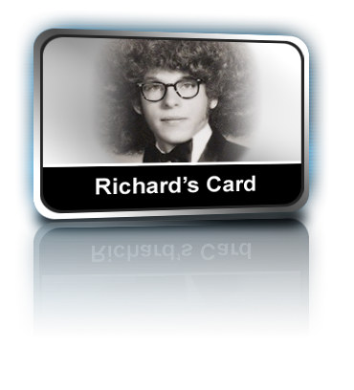

cards
self-issued
managed
contains claims about my identity that I assert
not corroborated
stored locally
signed and encrypted to prevent replay attacks
provided by banks, stores, government, clubs, etc
locally stored cards contain metadata only!
data stored by identity provider and obtained only when card submitted
Notes:
Cards contain no actual identity data – only metadata:
A list of the claims that a card represents
Where to go in order to obtain the claims
A signature identifying the card
The actual data behind a card is dynamically obtained from the IP:
From a local store for “self-issued cards”
From the Identity Provider’s Secure Token Service (STS) for “managed cards”
17

Slide 18


login with self issued card
user
object tag
login
relying party (website)

Slide 19

select self issued card
Planky
user
relying party (website)

Slide 20


create token from card
Planky
FN: Steve
LN: Plank
Email: splank
CO: UK
user
relying party (website)

Slide 21

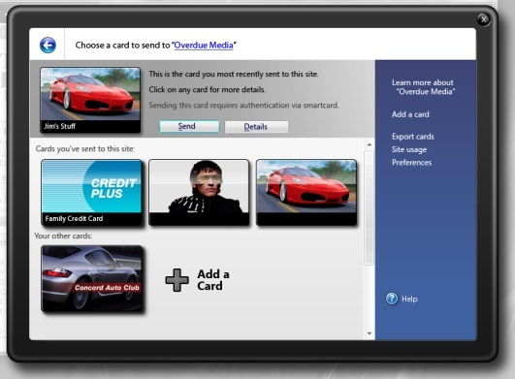

sign, encrypt & send token
Planky
user
relying party (website)

Slide 22
login with managed card
user
object tag
login
identity provider
relying party (website)

Slide 23

select managed card
Woodgrove
Bank
user
identity provider
relying party (website)

Slide 24


request security token
Woodgrove
Bank
user
authN:
X509, kerb, SC, U/pwd
…
identity provider
relying party (website)

Slide 25
request security token response
Woodgrove
Bank
user
sign, encrypt
send
identity provider
relying party (website)

Slide 26
<body>
<form id="form1" method="post" action="login.aspx">
<div>
<button type="submit">
Click here to sign in with your Information Card
</button>
<object type="application/x-informationcard" name="xmlToken">
<param name="tokenType" value="urn:oasis:names:tc:SAML:1.0:assertion" />
<param name="issuer value="http://schemas.xmlsoap.org/ws/2005/05/identity/issuer/self" />
<param name="requiredClaims" value="
http://schemas.xmlsoap.org/ws/2005/05/identity/claims/givenname
http://schemas.xmlsoap.org/ws/2005/05/identity/claims/surname
http://schemas.xmlsoap.org/ws/2005/05/identity/claims/emailaddress
http://schemas.xmlsoap.org/ws/2005/05/identity/claims/
privatepersonalidentifier
/>
</object>
</div>
</frm>
</body>

Slide 27
xmlToken
(signed &
encrypted)
token
decrypter
relying party (website)
xmlToken
(plaintext)
claims
extractor
ppid
456
user database
first name
last name
index into DB
email
123
456
789
phone

Slide 28
demo

Slide 29


roadmap
B1
CTP
B2
RCx
V1
RTM
Q1
2005
Q2
Q3
Q4
Q1
2006
Q2
Q3
Q4
Built into Windows Vista
Available for Windows XP & Windows Server 2003
Betas & CTPs available from:
http://msdn.microsoft.com/windowsvista/getthebeta
RTM 2nd half 2006
More Information & Samples at http:/cardspace.netfx3.com

Slide 30
review
identity layer
phishing, phraud
human integration
consistent experience across contexts
ip
rp
user
identity selector
Presentation style mercilessly stolen off
Lawrence Lessig, BBC News 24 and Dick Hardt

